Slide 1
History and Modern-Day Structure and Function of the EHR
BDK08-3 | Secondary Use (Re-Use) of Clinical Information
William Hersh, MD | Department of Medical Informatics & Clinical Epidemiology
Oregon Health & Science University

Slide 2
History and perspective of the medical record
Perspective of its evolution over the centuries
Data can be organized as
Practitioner (physician)-centered
Patient-centered
Orientations (not mutually exclusive) include
Time-oriented – organized chronologically
Department-oriented – organized by department
Problem-oriented – organized by focus on problems
(Siegler, 2010)

Slide 3
History and perspective (cont.)
Earliest medical records were physician-oriented
Hippocrates said over 2,500 years ago that the medical record should
Accurately reflect course of disease
Indicate possible causes of disease
Before era of widespread medical diagnostic testing, record consisted mostly of observations

Slide 4
Some early innovations came from Mayo Clinic
All physicians kept all their notes in leather-bound ledger
In 1907, moved from physician-centered to patient-centered record
Mayo was also pioneer in defining data elements to be recorded, forerunner of modern efforts in epidemiology and classification

Slide 5
Some terminology of the medical record
Electronic health record (EHR) – subsumes
Electronic medical record (EMR)
Computer-based patient record (CPR)
Some other terms of note
Practice management system (PMS)
Registry
Personal health record (PHR)
Problem-oriented medical record (POMR)
Legacy systems

Slide 6
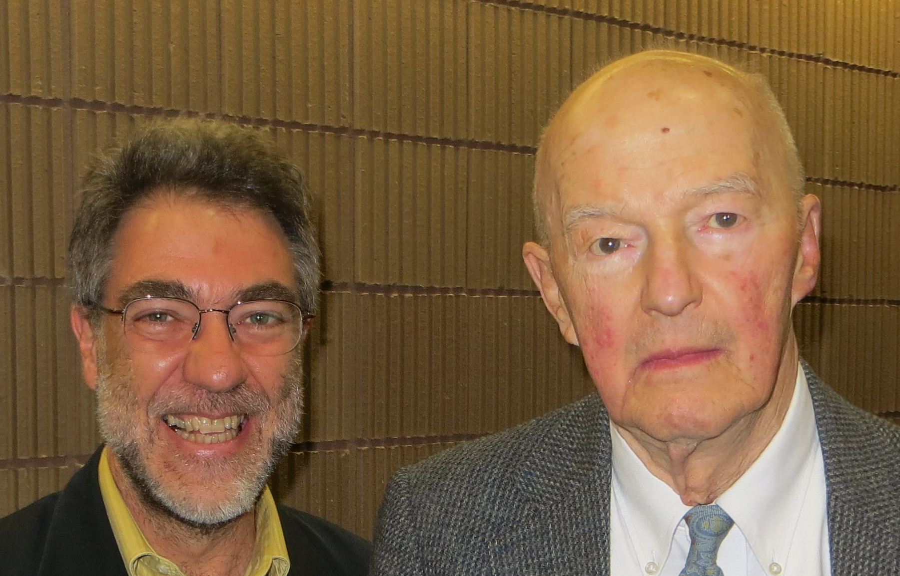
The problem-oriented medical record (POMR)
Proposed by Weed (1969)
All entries grouped under particular problems
An encounter for each problem is organized under four headings
Subjective – what patient reports
Objective – what clinician observes or measures
Assessment – what clinician assesses
Plan – what clinician plans to do
Most common usage is to have entire encounter organized by SOAP format, not individual problems
Just one of many contributions of Weed (Wright, 2014)
(Wright, 2014)

Slide 7
Alternatives to the POMR
Rethink some language?
Chief complaint → Chief concern
Present illness should be described from both biological and patient experience perspectives
SOAP should be HOAP – history, observations, assessment, plan
Need to reorganize for easier reading the EHR?
Several practices found to prefer APSO over SOAP for authoring and reading
(Donnelley, 2005), (Lin, 2013)

Slide 8
The modern-day medical record
Mixture of patient- and problem-oriented approaches
In general, each provider or institution maintains its own record
The creator of the medical record is assumed to be its “owner,” although patients can request access
In US is slowly moving away from paper-based
Even worse may be “hybrid,” with some data on paper, some electronic, and some on both media

Slide 9

Flow of information in primary care practice
Figure from Bates, DW, Ebell, M, et al. (2002). A proposal for electronic medical records in U.S. primary care. Journal of the American Medical Informatics Association. 10: 1-10
(Bates, 2002)

Slide 10
Additional challenges in the modern era
Coordinating care requires better communication among providers
Increasing cost of care requires justification and documentation of expenditures
Patients change plans, so their records should be portable
US still spends several $B per year copying medical records for this and other reasons
Informed consumers desire more participation in care decisions, which includes access to their records
They also want security and other protections of their information
No single vendor has complete solution
Many take “best of breed” approach to matching components
Now must align goals for EHR adoption with HITECH and meaningful use

Slide 11
Some limitations of the paper-based record
Summarized by Dick (1997), recently exemplified by
“A Day in the Life…” by Morrissey (2006)
“In the Dark…” by Litvin (2007)
Single user – one person at a time
Disorganized – especially for complex patients
Incomplete – reports missing or lost, some providers not sharing their reports with the rest
Insecure – no audit trail, easily copied or stolen

Slide 12
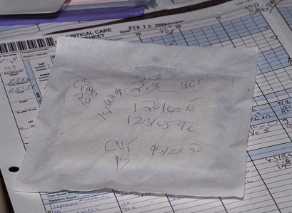
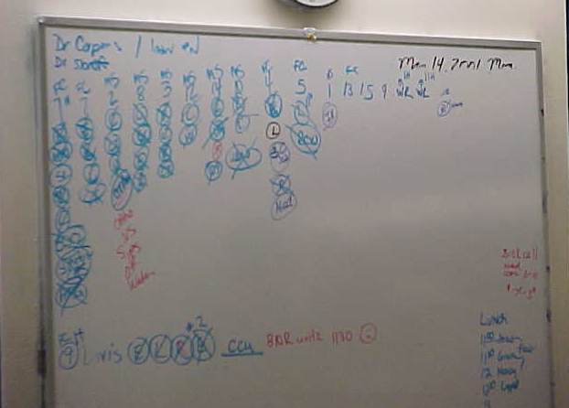
But there are still many conveniences with paper and/or writing…

Slide 13
Thank you
This course was made possible under a grant from the NIH (# 1R25GM114820-01)

